Slide 1
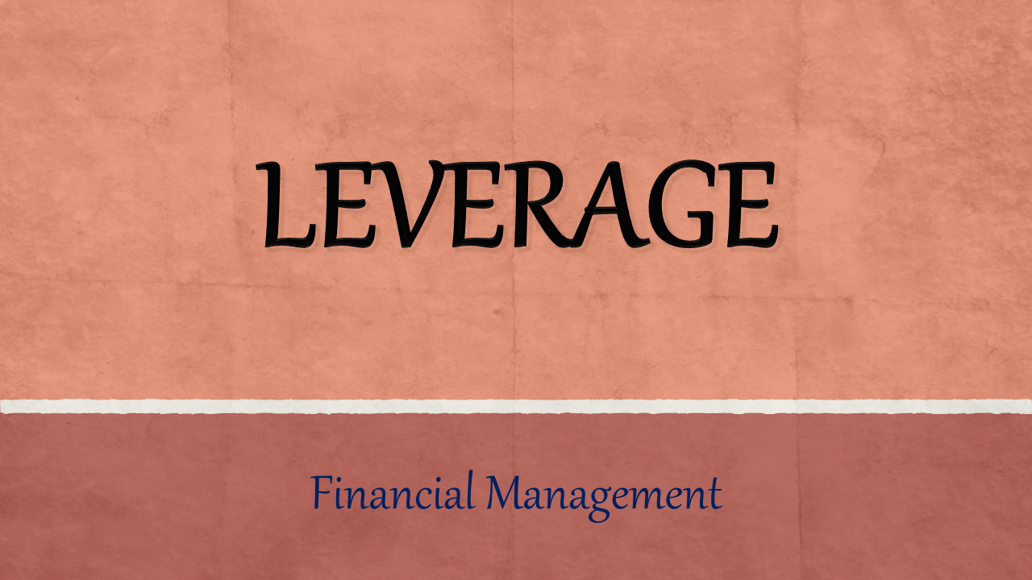

Slide 2
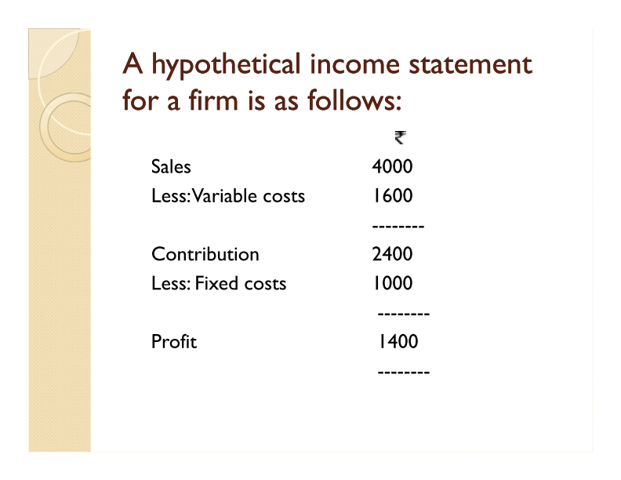

Slide 3
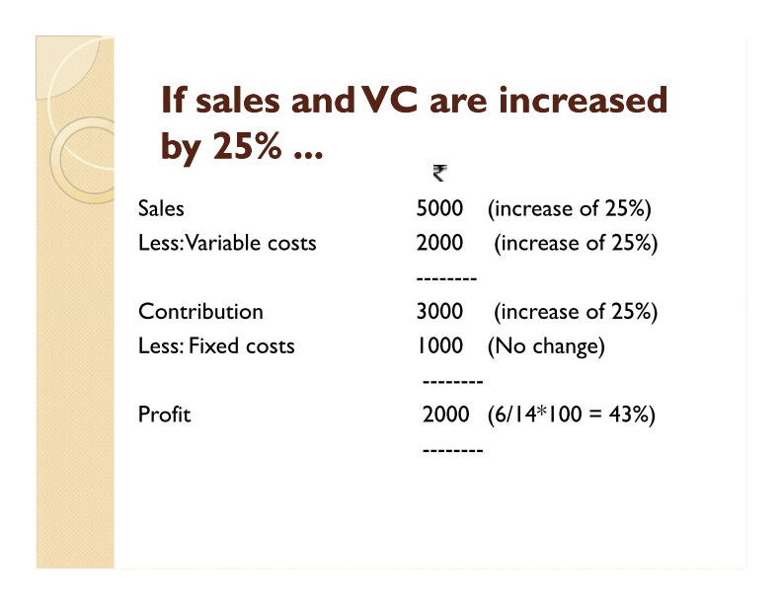

Slide 4
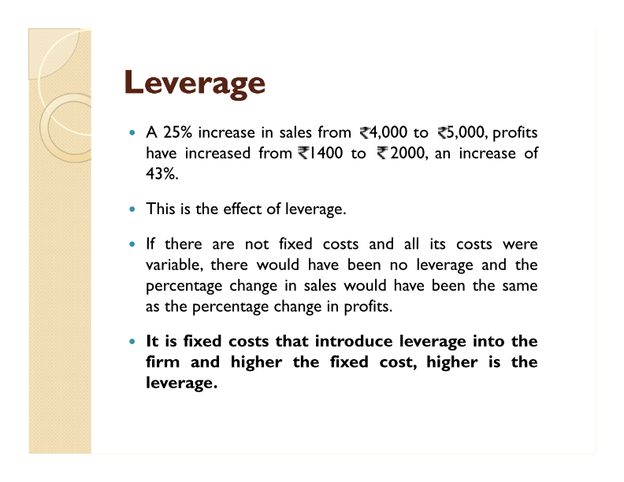

Slide 5
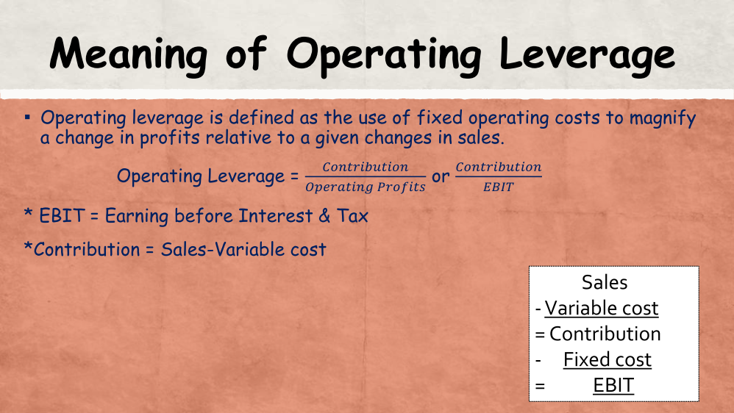

Slide 6
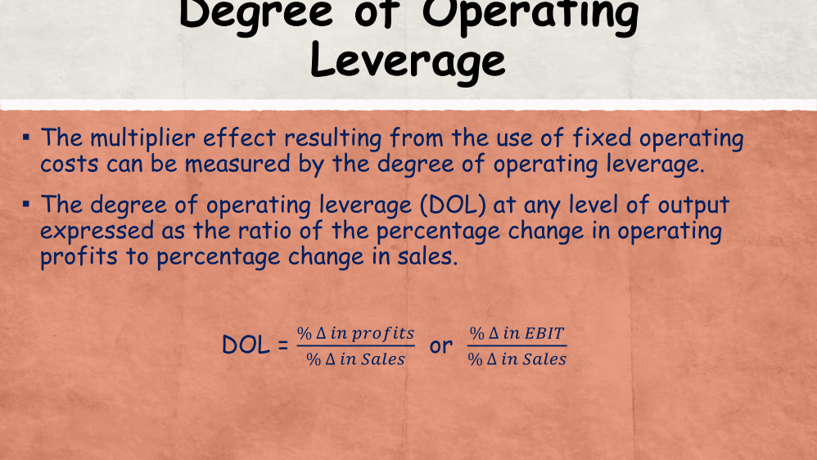

Slide 7
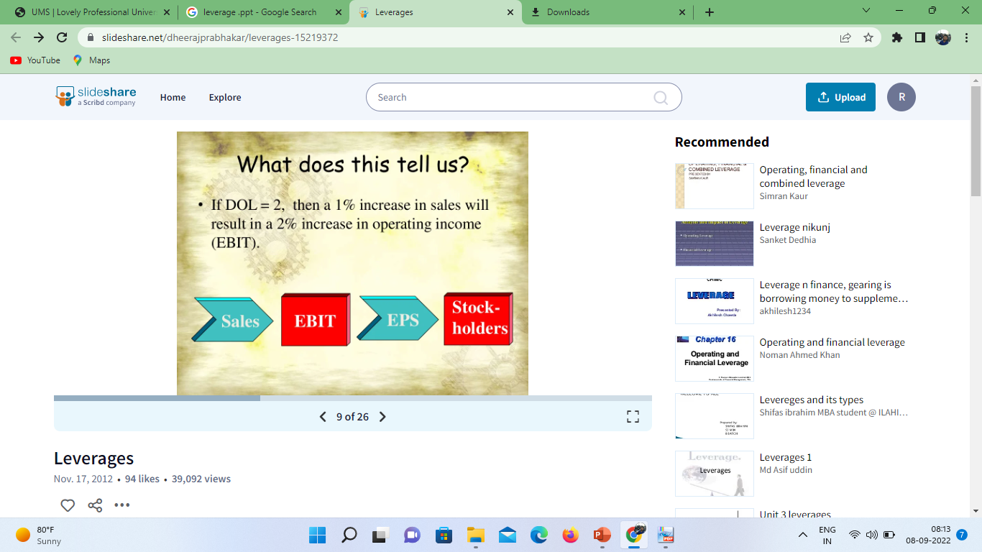

Slide 8
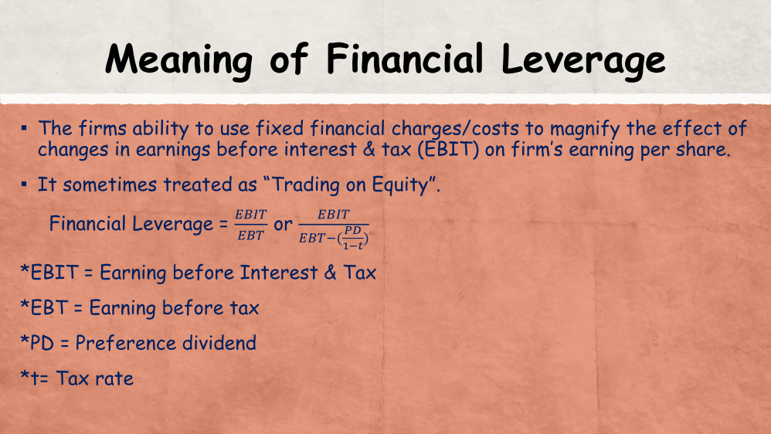

Slide 9
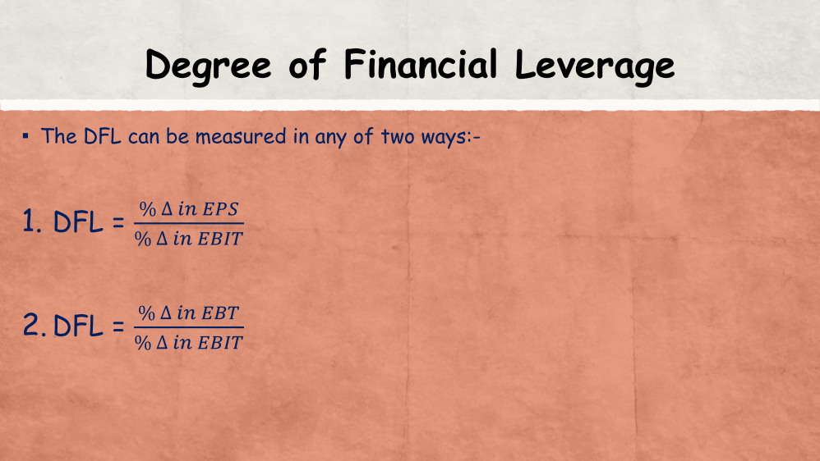

Slide 10
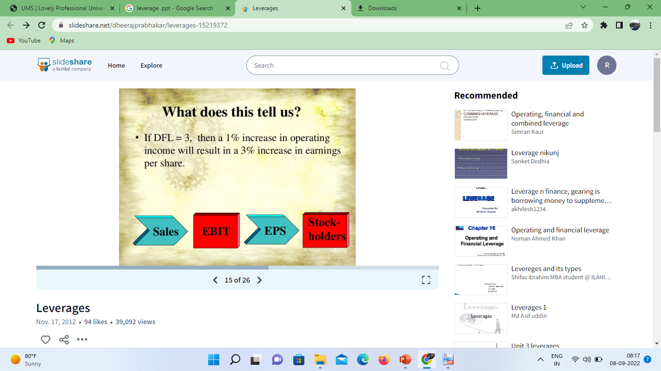

Slide 11
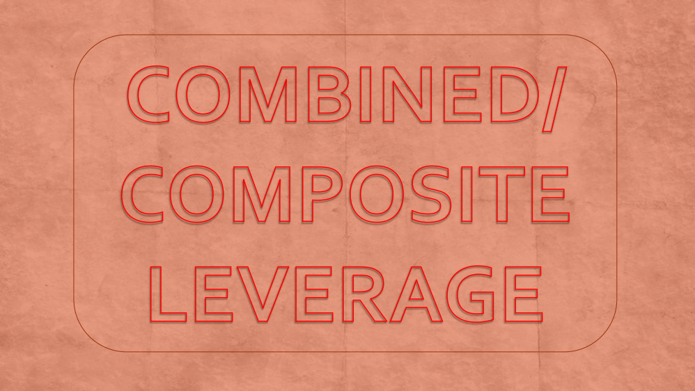

Slide 12
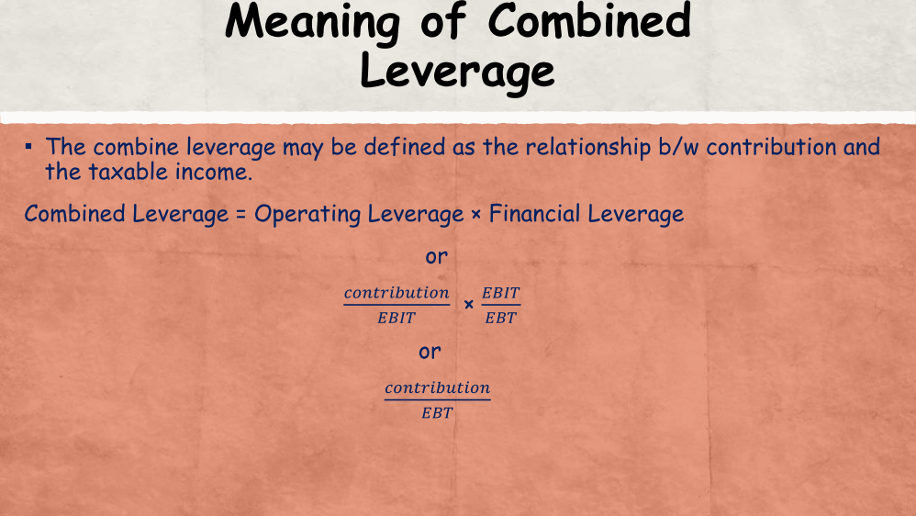

Slide 13
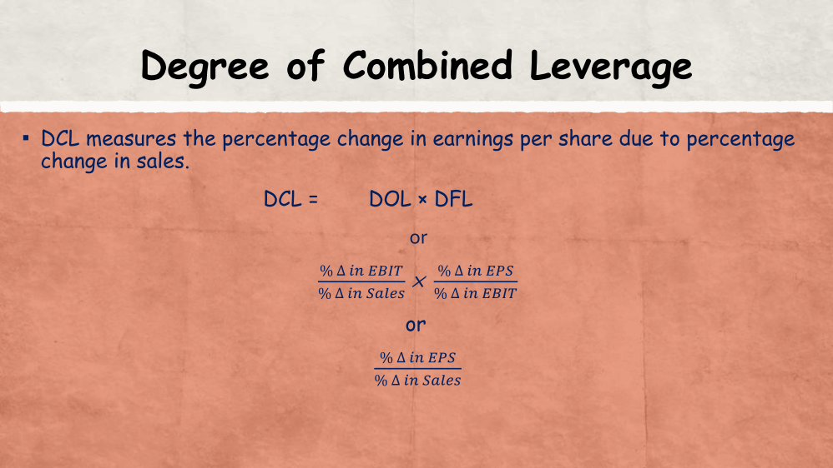

Slide 14

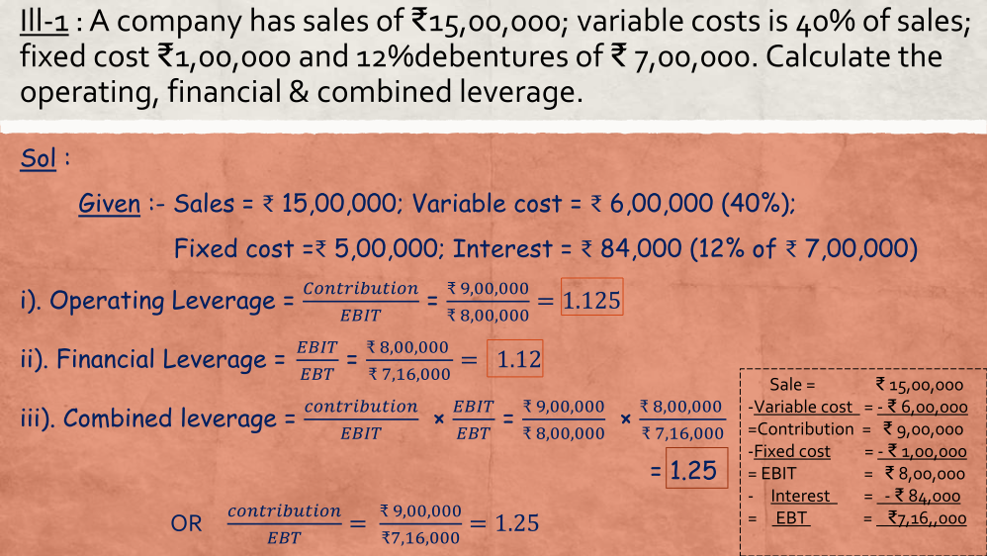

Slide 16
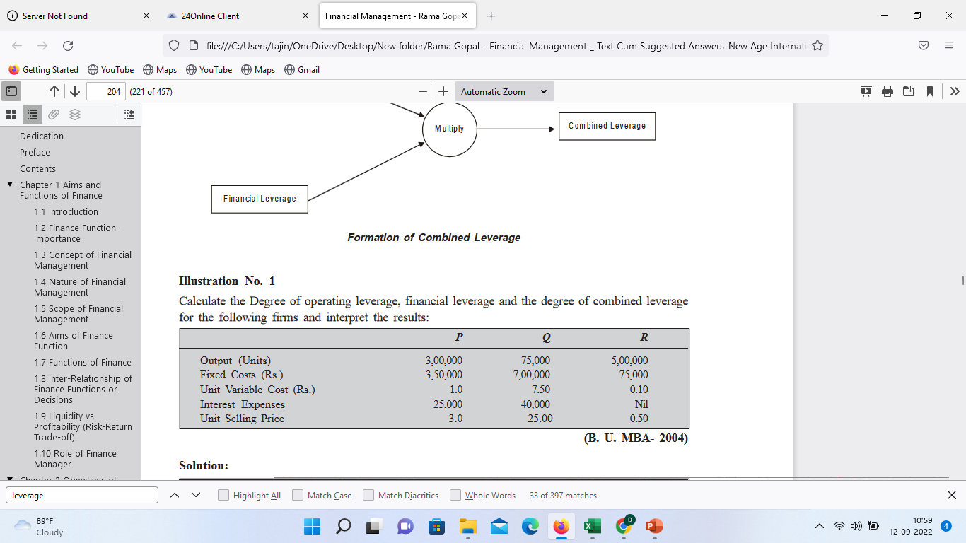

Slide 17
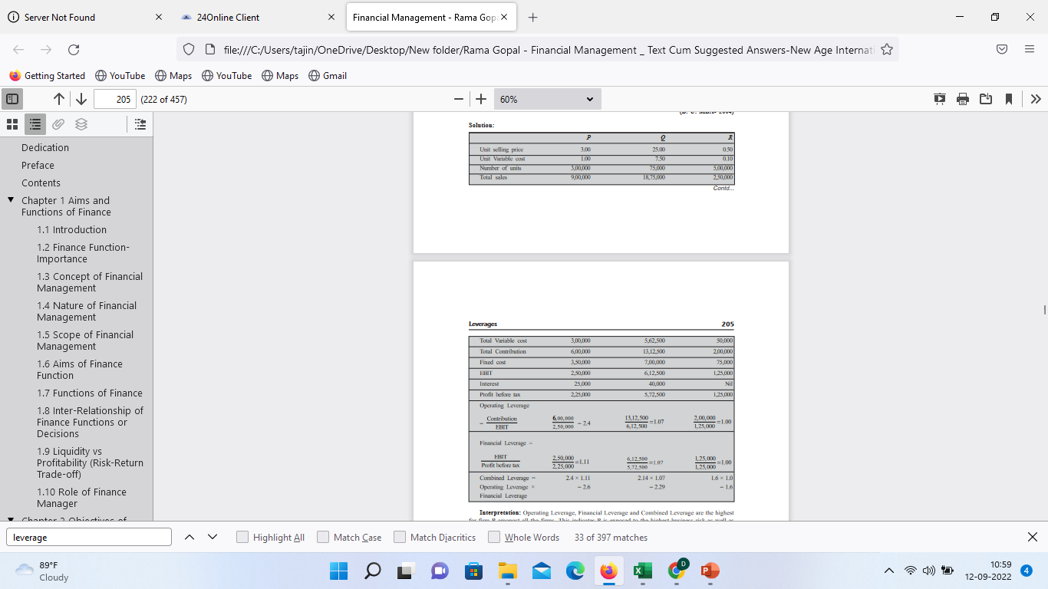

Slide 19
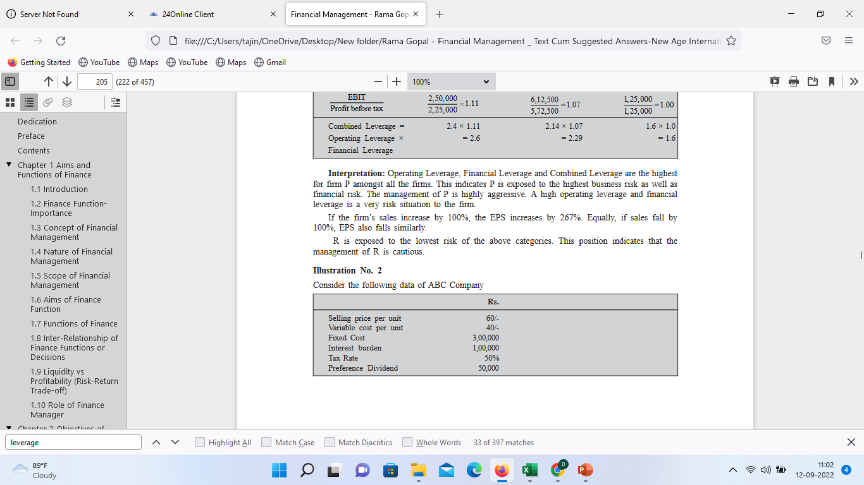
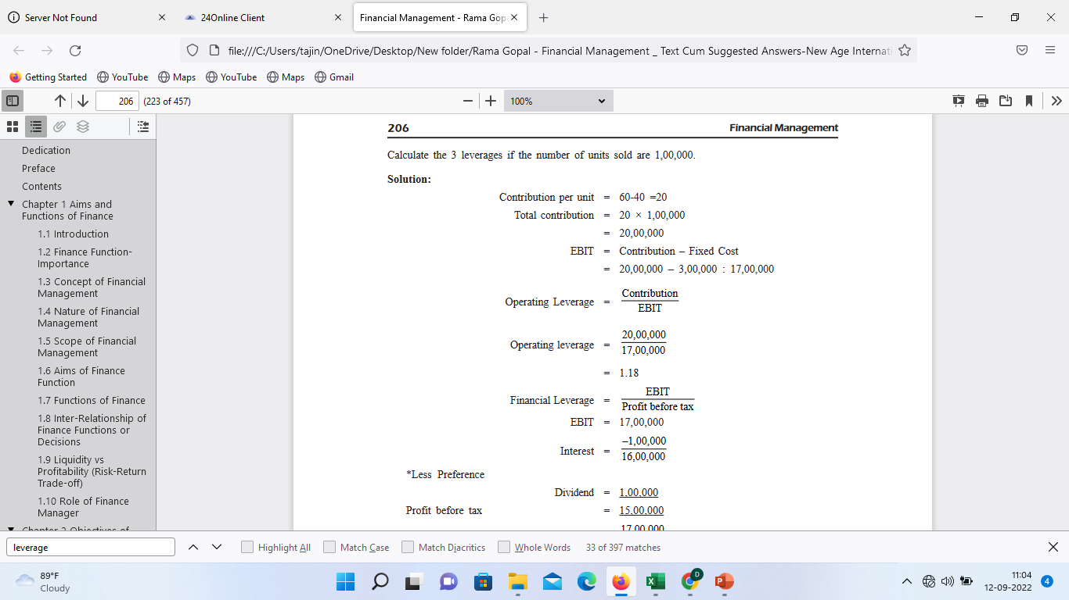

Slide 21
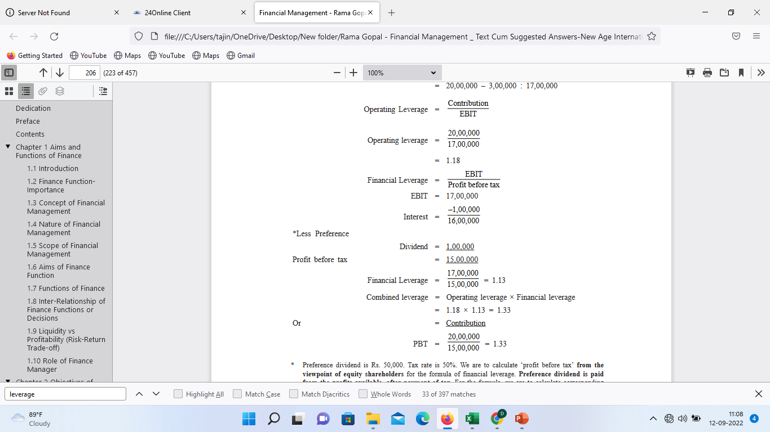

Slide 22
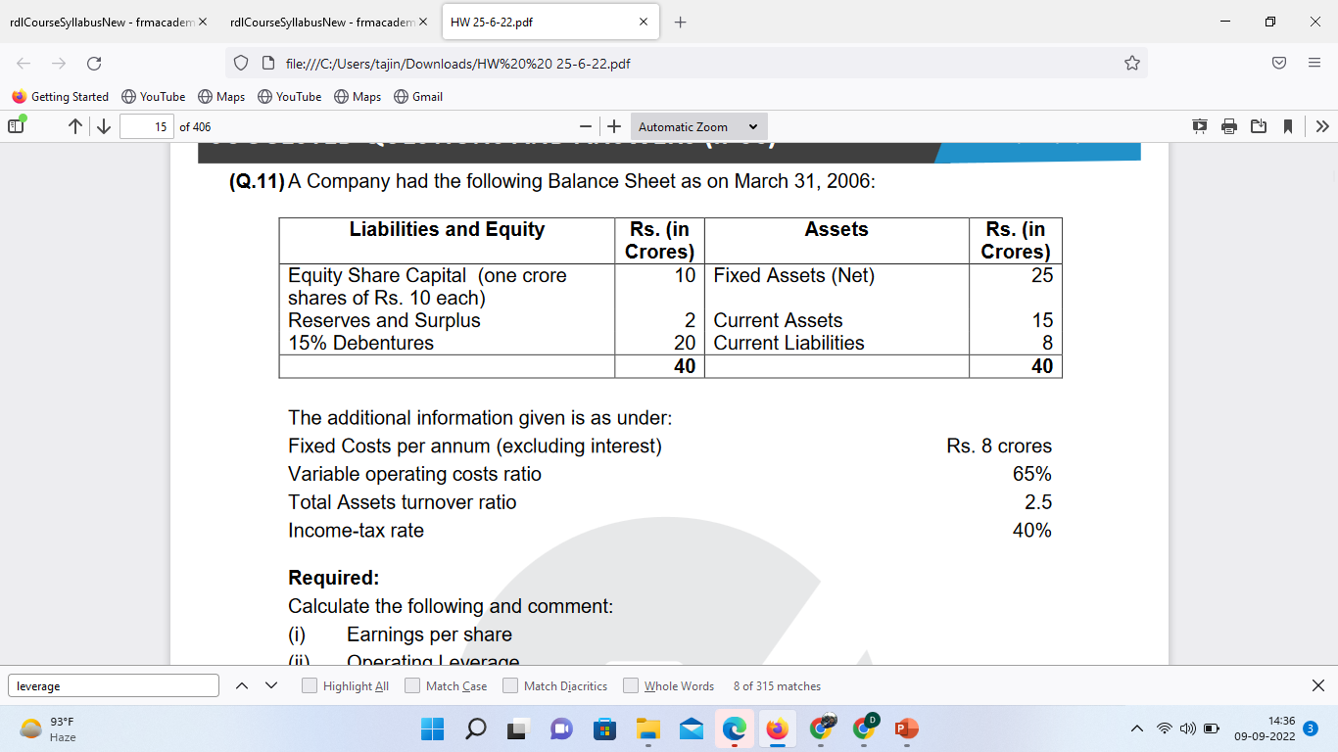

Slide 23
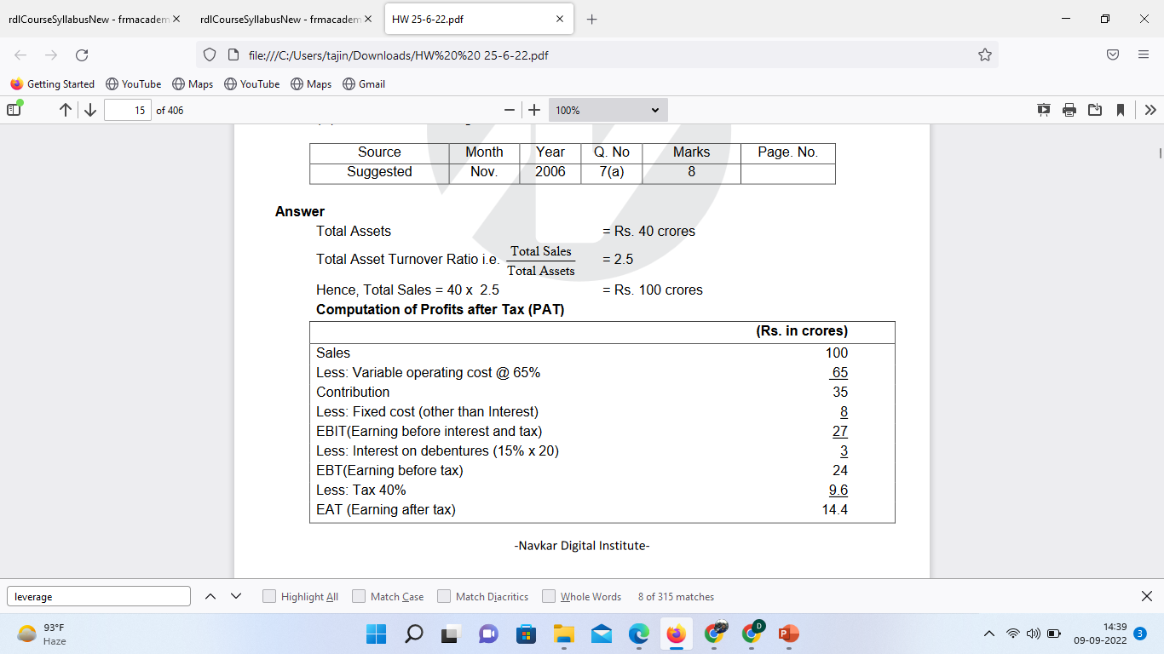

Slide 24
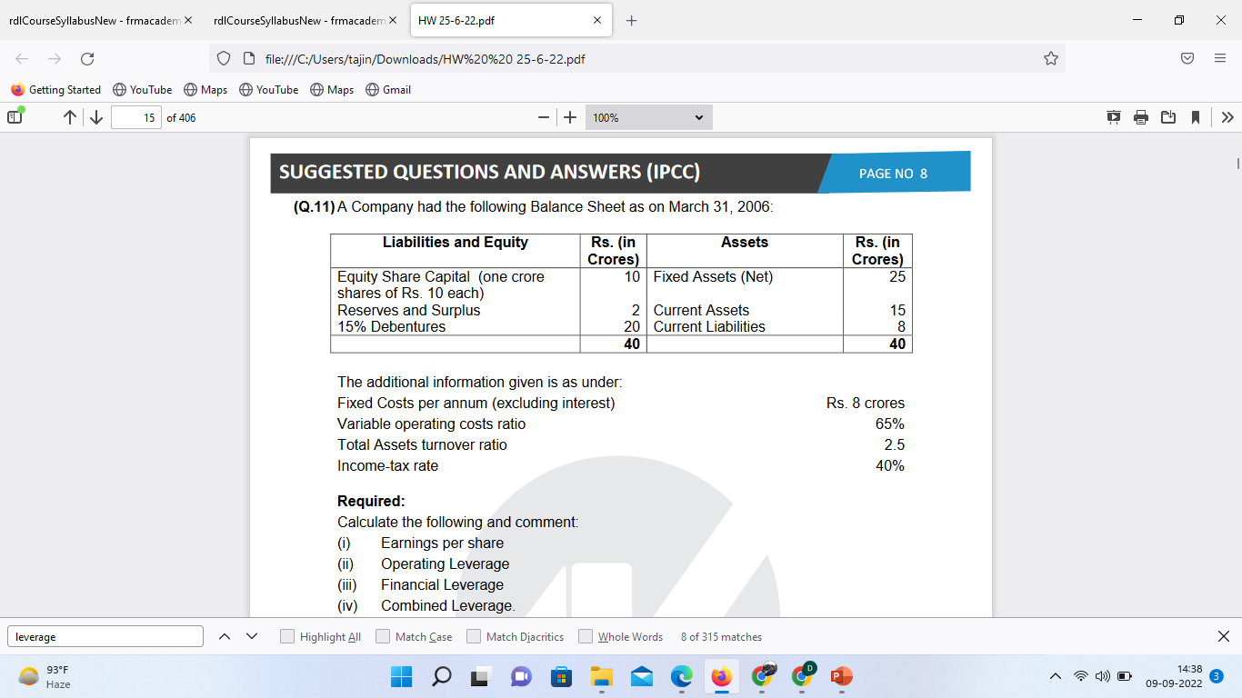

Slide 25
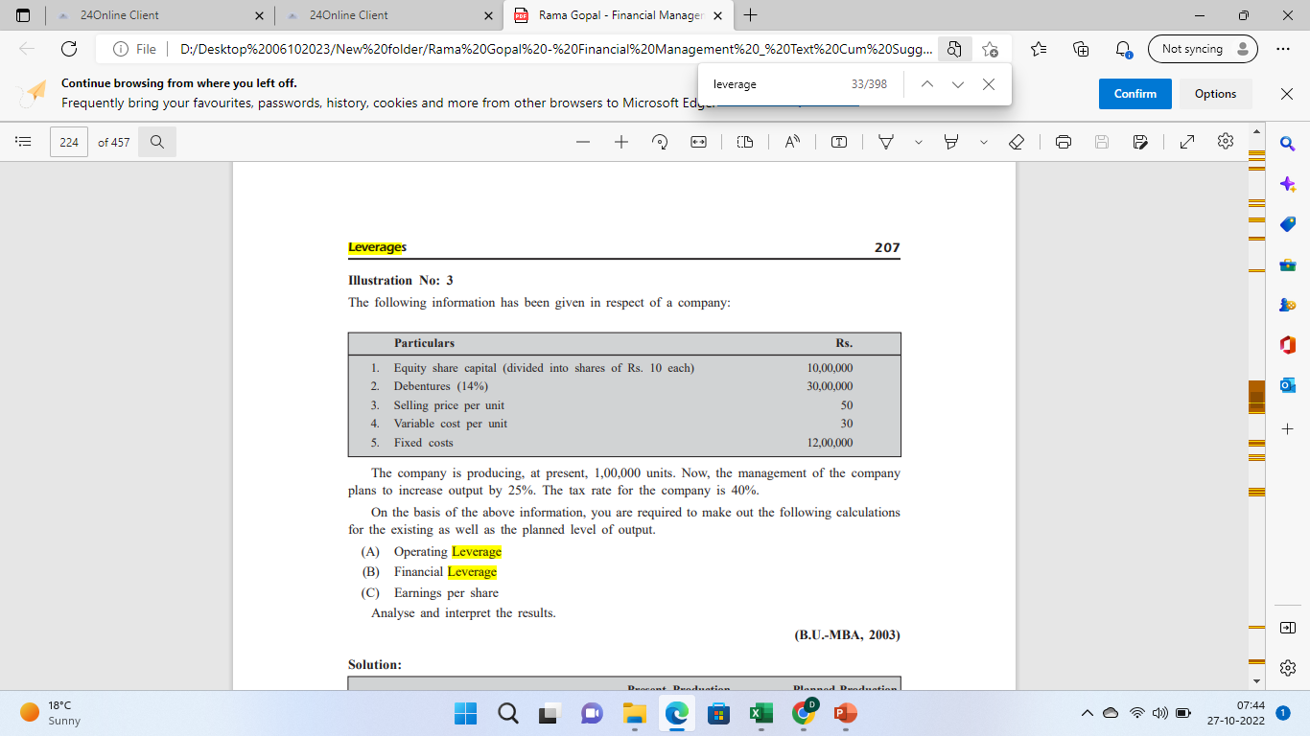

Slide 26
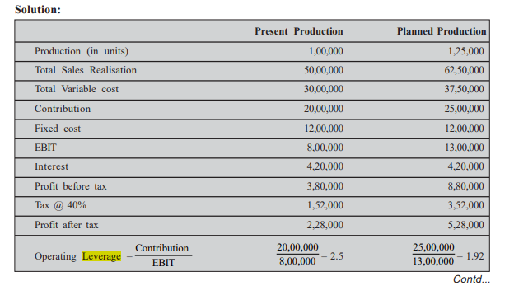

Slide 27
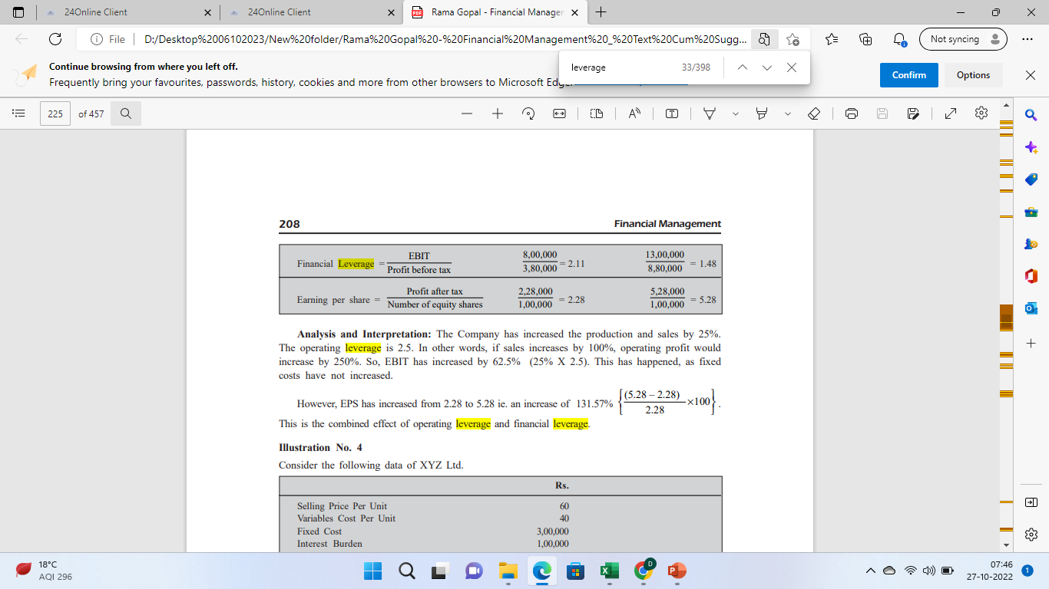

Slide 28
A firm sells products for Rs 100 per unit, has variable operating costs of Rs 50 per unit and fixed operating costs of Rs 50,000 per year. Show the various levels of EBIT that would result from sale of (i) 1,000 units (ii) 2,000 units and (iii) 3,000 units

Slide 29
A firm sells its products for Rs 50 per unit, has variable operating costs of Rs 30 per unit and fixed operating costs of Rs 5,000 per year. Its current level of sales is 300 units. Determine the degree of operationg leverage. What will happen to EBIT if sales change: (a) rise to 350 units, and (b) decrease to 250 units

Slide 30
The operating and cost data of ABC Ltd are : Sales ` 20,00,000 Variable costs 14,00,000
Fixed costs 4,00,000 (including 15% interest on ` 10,00,000)
(i) Calculate its operating, financial and combined leverages.
(ii) Determine the additional sales to double its EBIT

Slide 31
ANSWER
Operating leverage = 1.71
Financial leverage = 1.75
Combined leverage = 2.99

Slide 32
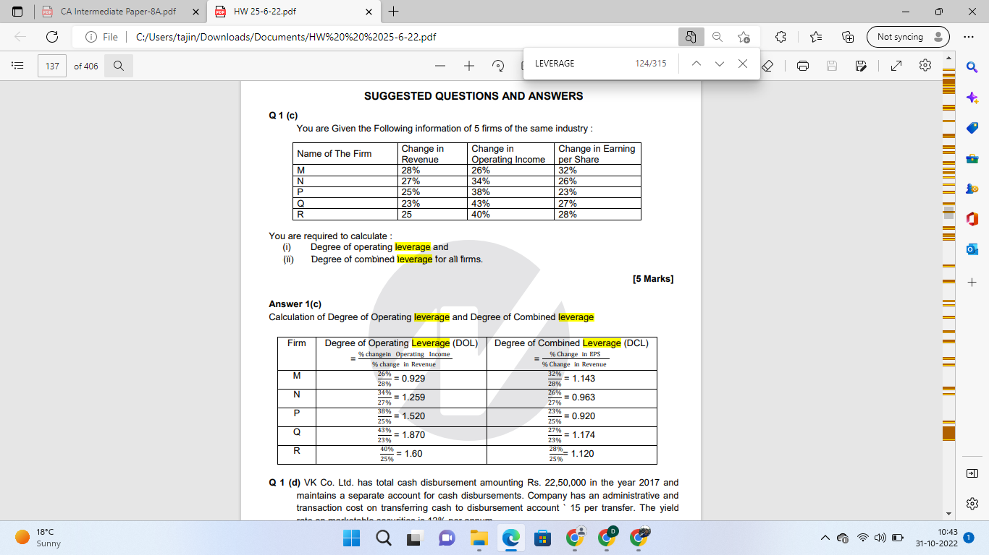

Slide 34
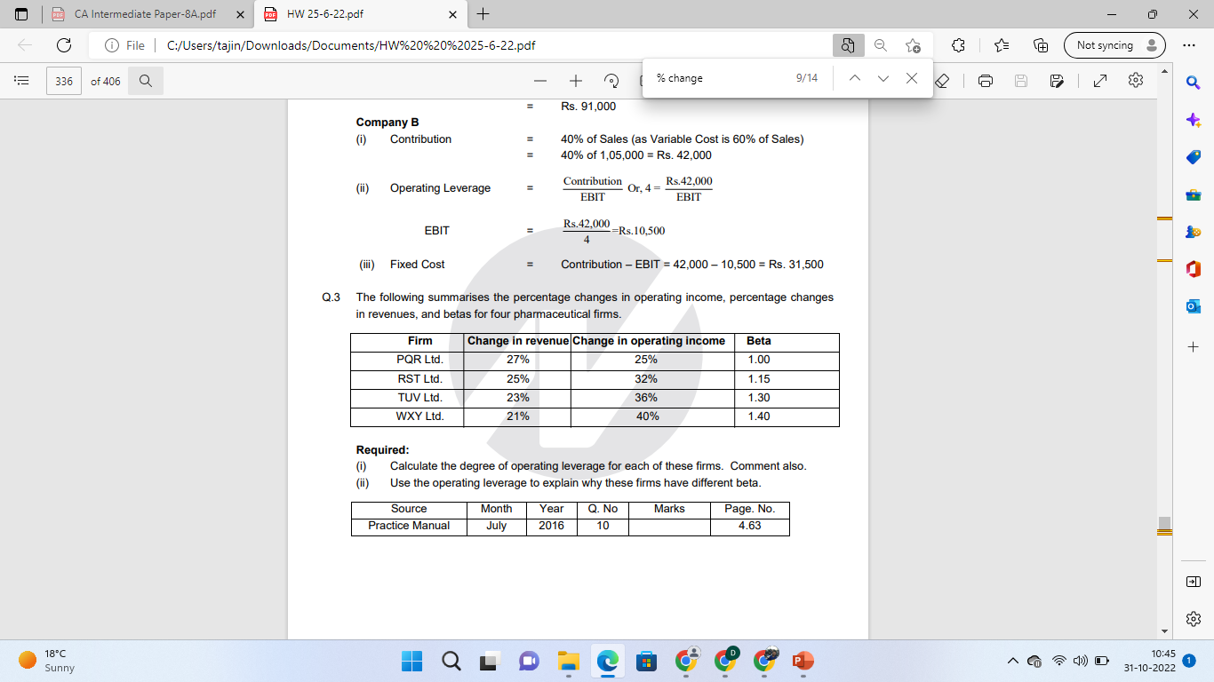

Slide 35
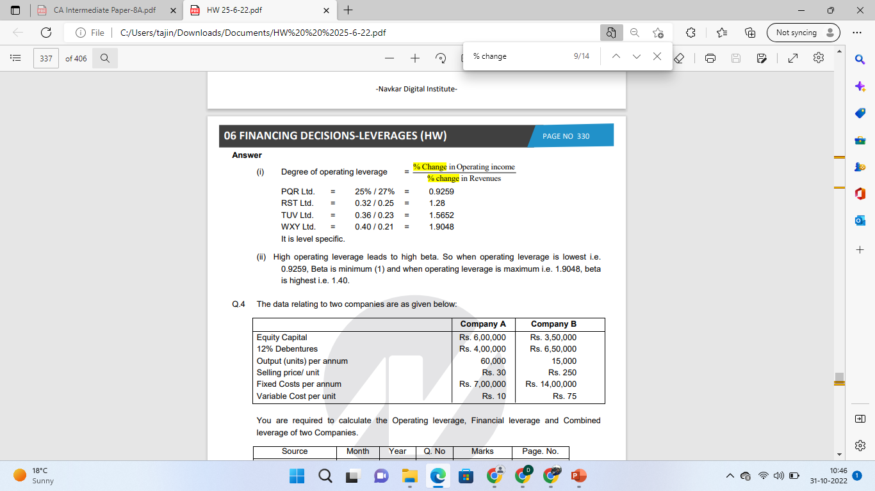

Slide 36
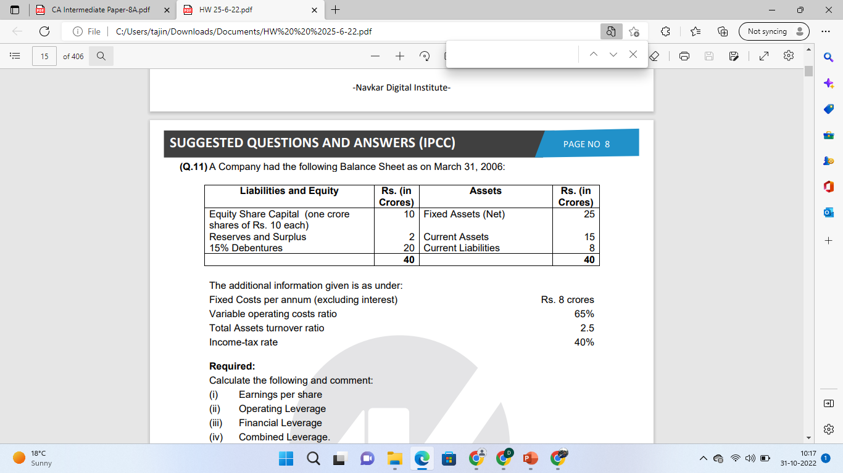

Slide 37
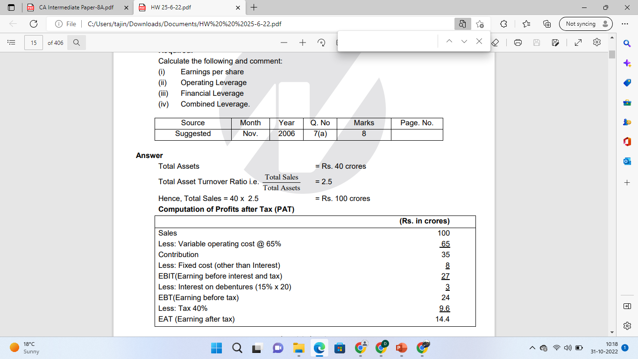

Slide 38
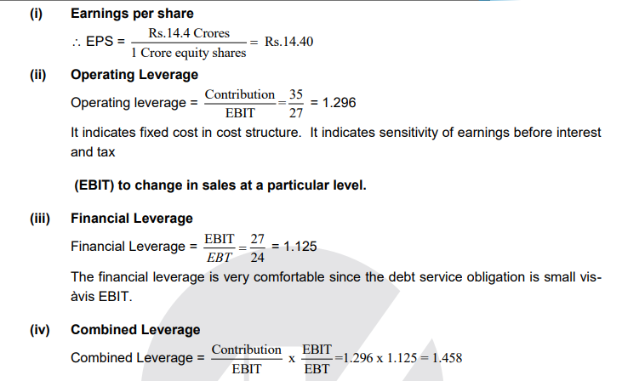

Slide 39
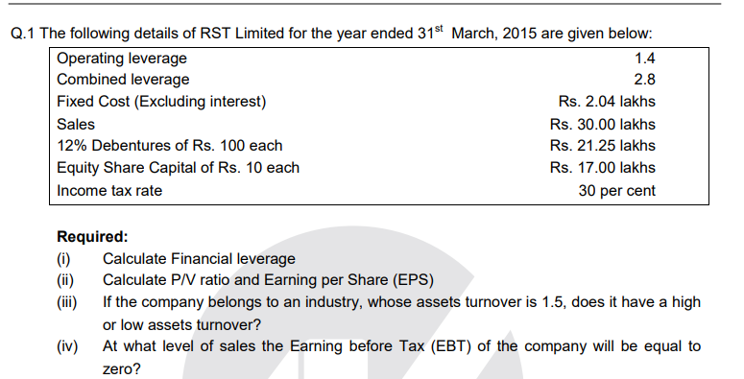

Slide 40
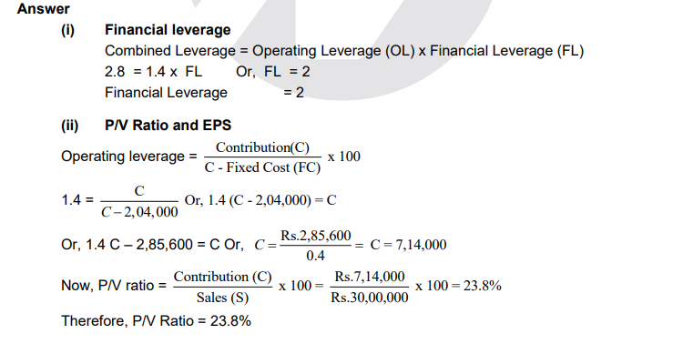

Slide 41
A firm has Sales of Rs. 40 lakhs; Variable cost of Rs. 25 lakhs; Fixed cost of Rs. 6 lakhs; 10% debt of Rs. 30 lakhs; and Equity Capital of Rs. 45 lakhs

Slide 42
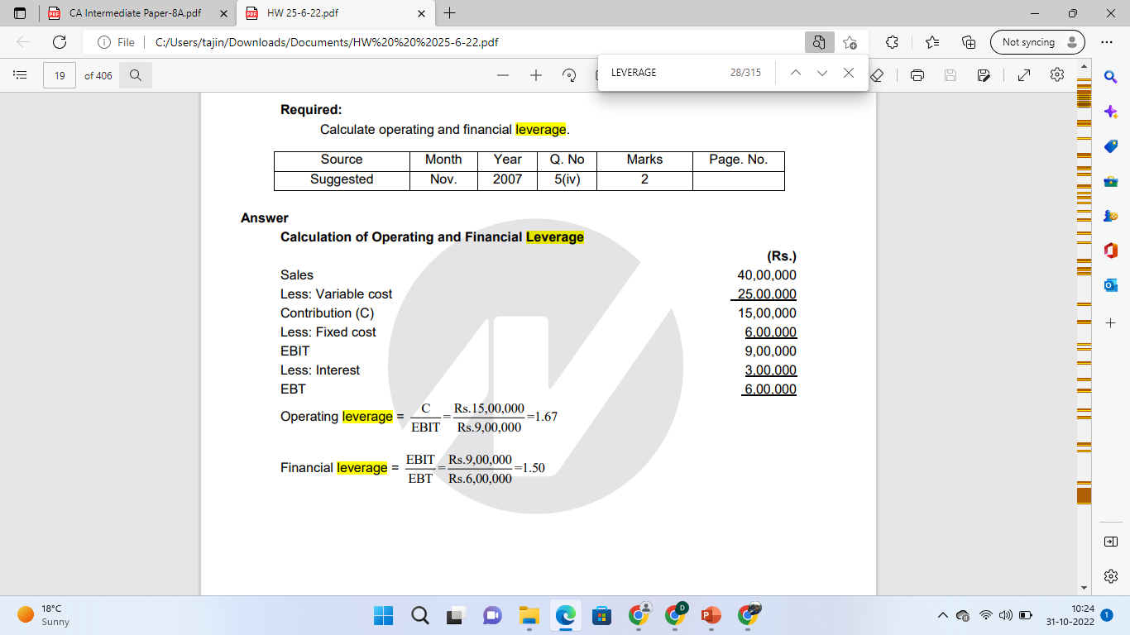

Slide 43
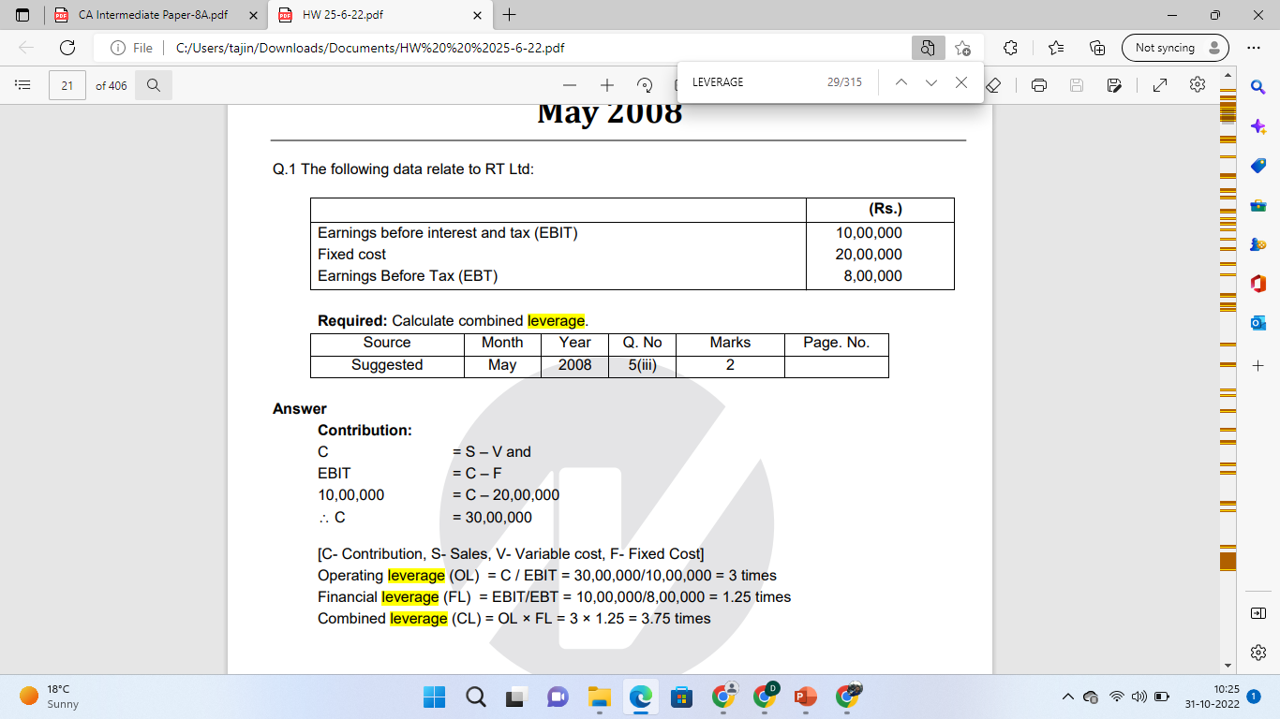

Slide 45
A company operates at a production level of 1,000 units. The contribution is Rs. 60 per unit, operating leverage is 6, and combined leverage is 24. If tax rate is 30%, what would be its earnings after tax?

Slide 46
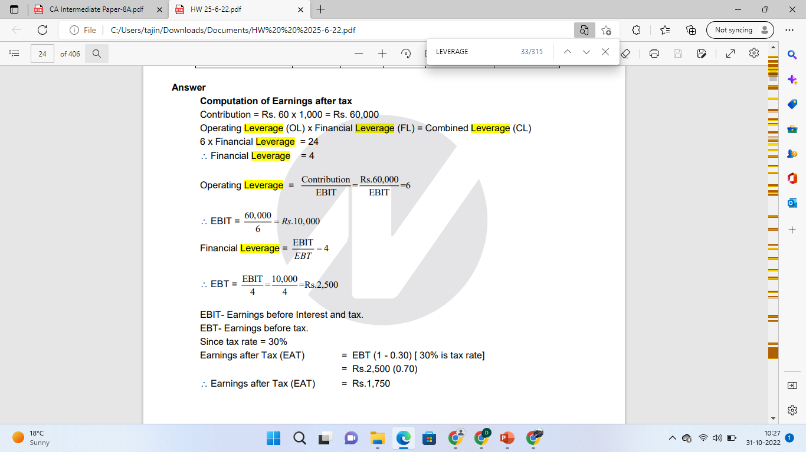

Slide 47
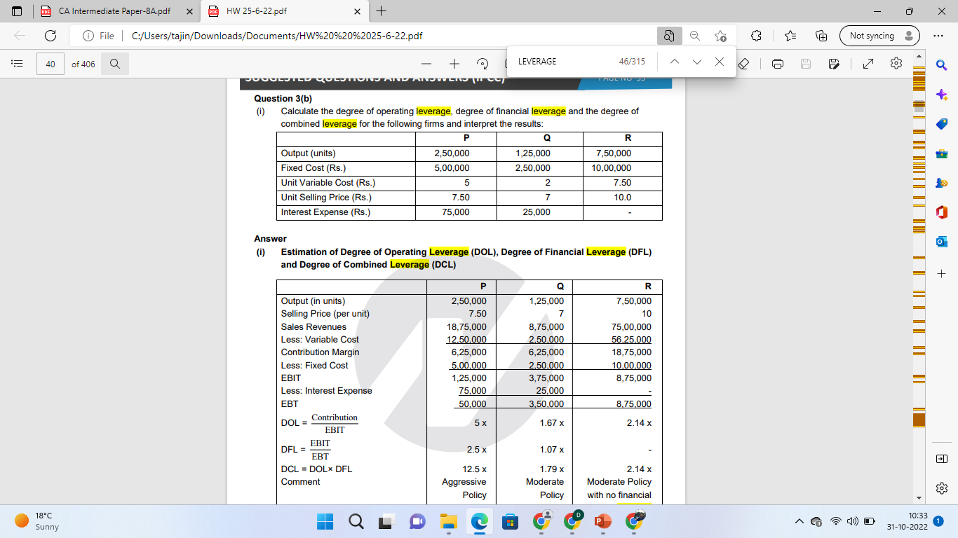

Slide 49
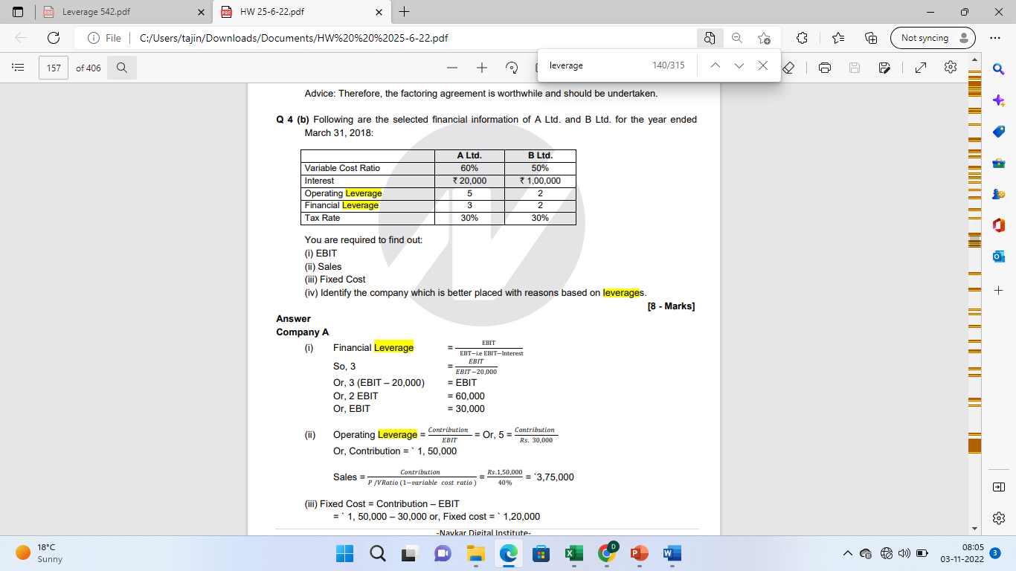

Slide 50
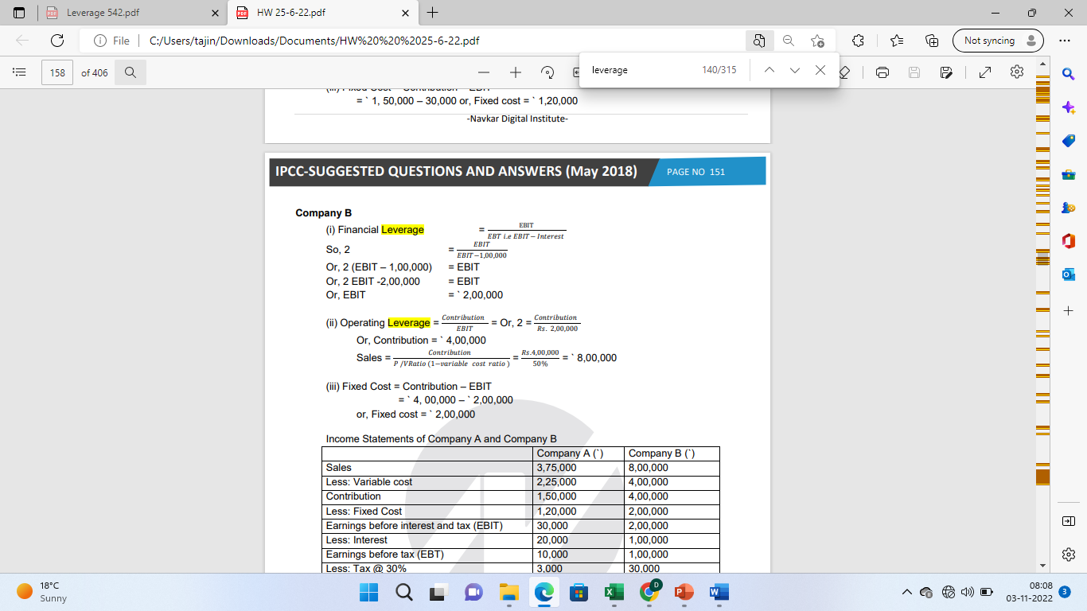

Slide 51
Q 1 (d) A Company has Sales of ` 1,00,00,000; variable Cost is 55% of Sales and fixed Cost is ` 6,00,000. The Capital Structure of the company is: Equity ` 1,20,00,000 and 8% Debt ` 80,00,000.
Required: (i) Calculate Company's Operating, Financial and Combined Leverages. (ii) If the Sales amount is increased by 12%, by what percentage EBIT will increase?

Slide 52
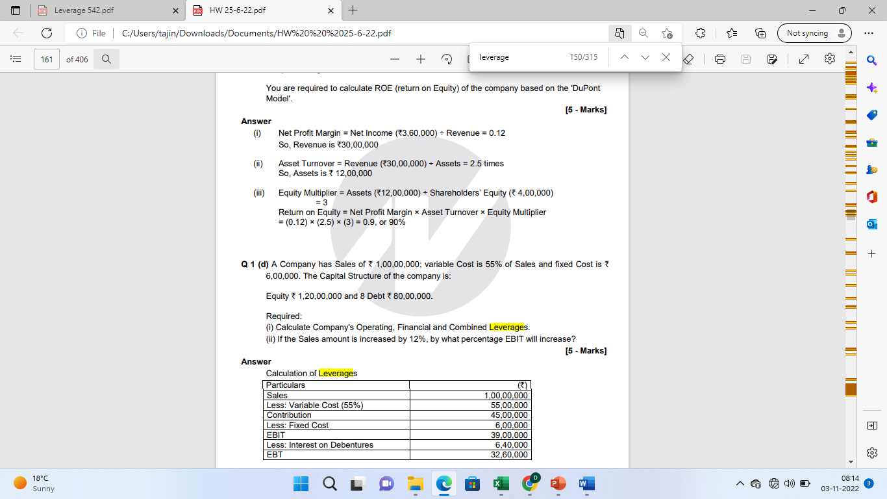
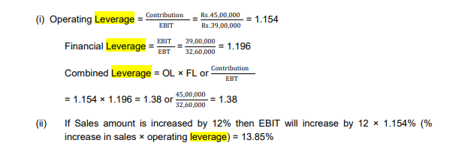

Slide 53
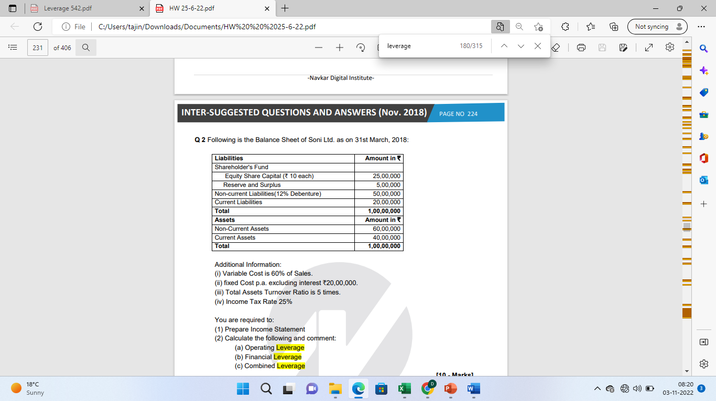

Slide 54
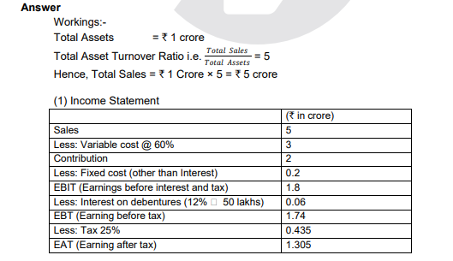

Slide 55
